Slide 1




Lecture 9 Ms. Maham Mehr Awan
Achieving Qualities

Slide 2
SECURITY
Security is a measure of the system's ability to resist unauthorized usage while still providing its services to legitimate users.
An attempt to breach security is called an attack and can take a number of forms.
It may be an unauthorized attempt to access data or services
or to modify data,
or it may be intended to deny services to legitimate users.

Slide 3
SECURITY
Security can be characterized as a system providing;
Nonrepudiation:
is the property that a transaction (access to or modification of data or services) cannot be denied by any of the parties to it.
Confidentiality:
is the property that data or services are protected from unauthorized access.
Integrity:
is the property that data or services are being delivered as intended.
Notes:
For example, if you take a pen and sign a (legal) contract your signature is a nonrepudiation device. You cannot later disagree to the terms of the contract or refute ever taking party to the agreement.

Slide 4
SECURITY
Security can be characterized as a system providing;
Assurance:
is the property that the parties to a transaction are who they purport to be for legitimate use.
auditing:
is the property that the system tracks activities within it at levels sufficient to reconstruct them.

Slide 5
Security Tactics
Tactics for achieving security can be divided into those concerned with
resisting attacks,
those concerned with detecting attacks,
and those concerned with recovering from attacks. All three categories are important.
Using a familiar analogy,
putting a lock on your door is a form of resisting an attack,
having a motion sensor inside of your house is a form of detecting an attack,
and having insurance is a form of recovering from an attack.

Slide 6
RESISTING ATTACKS
The following tactics can be used in combination to achieve security goals.
Authenticate users.
Authorize users
Maintain data confidentiality
Maintain integrity.
Limit exposure
Limit access

Slide 7
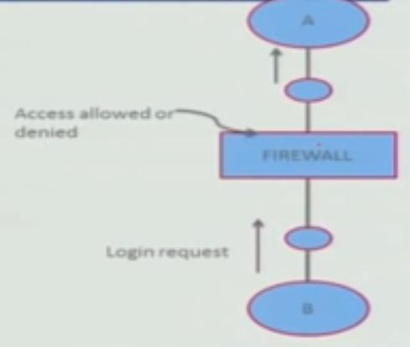
RESISTING ATTACKS
Authenticate users.
Authentication is ensuring that a user or remote
computer is actually who it purports to be.
Passwords, one-time passwords, digital certificates, and biometric identifications provide authentication.
Authorize users.
Authorization is ensuring that an authenticated user has the rights to access and modify either data or services.
This is usually managed by providing some access control patterns within a system.
Access control can be by user or by user class.
Classes of users can be defined by user groups, by user roles, or by lists of individuals.
Notes:
Purports → Claims

Slide 8
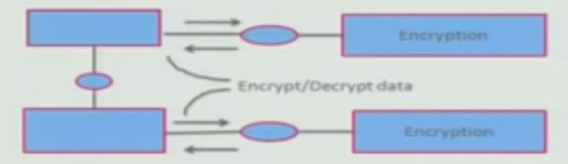
RESISTING ATTACKS
Maintain data confidentiality.
Data should be protected from unauthorized access.
Confidentiality is usually achieved by applying some form of encryption to
data
and to communication links.
Encryption provides extra protection to persistently maintained data beyond that available from authorization.
Encryption is the only protection for passing data over publicly accessible communication links.
Encryption can be;
Symmetric (both parties use the same key)
Asymmetric (public and private keys)

Slide 9
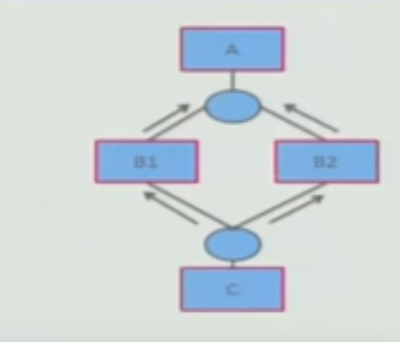
RESISTING ATTACKS
Maintain integrity.
Data should be delivered as intended.
It can have surplus information encoded in it, such as checksums or hash results, which can be encrypted either along with or independently from the original data.
Limit exposure.
Attacks typically depend on exploiting a single weakness,
to attack all data and services on a host.
The architect can design the allocation of services to
hosts so that limited services are available on each host.

Slide 10
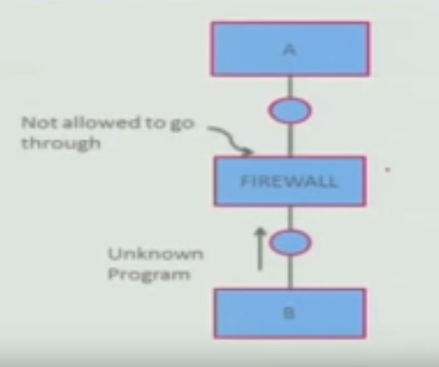
RESISTING ATTACKS
Limit access.
It is not always possible to limit access to known sources.
Firewalls restrict access based on message source or
destination port.
Messages from unknown sources may be a form of an attack.
A public Web site, for example, can expect to get requests from unknown sources.
One configuration used in this case is the so-called demilitarized zone (DMZ).
It sits between the Internet and a firewall in front of the internal network.
A DMZ is used when access must be provided to Internet services but not to a private network.
The DMZ contains devices expected to receive messages from arbitrary sources such as Web services, e-mail, and domain name services.

Slide 11
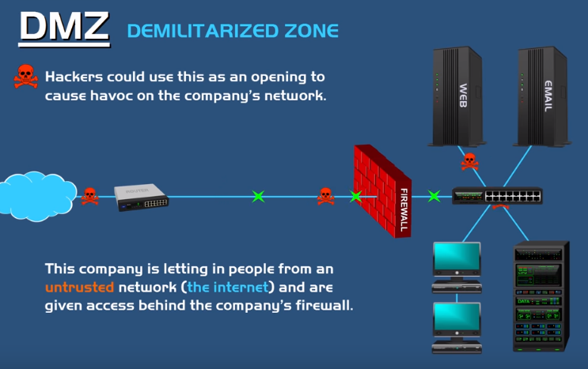
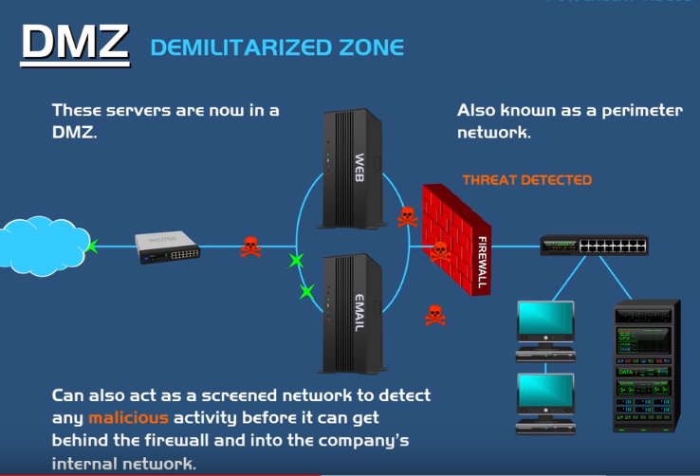
Demilitarized Zone (DMZ)

Slide 12
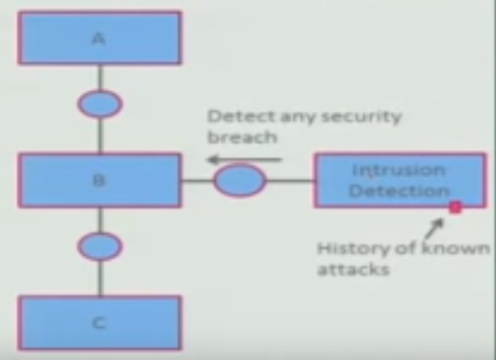
DETECTING ATTACKS
The detection of an attack is usually through an
intrusion detection system must have some sort of
sensor to detect attacks.
Such systems work by;
Comparing network traffic patterns to a database.
In the case of misuse detection, the traffic pattern is compared to historic patterns of known attacks.
In the case of anomaly detection, the traffic pattern is compared to a historical baseline of itself.
Frequently, the packets must be filtered in order to make comparisons.

Slide 13
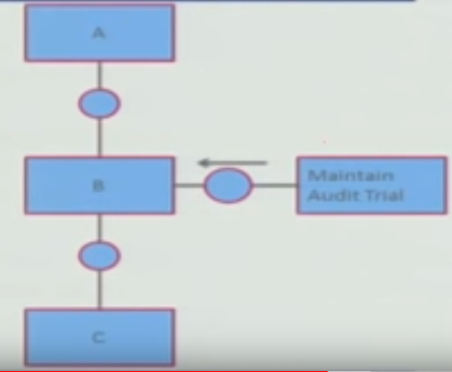
RECOVERING FROM ATTACKS
Tactics involved in recovering from an attack can be
divided into;
those concerned with restoring state
and those concerned with attacker identification (for either preventive or punitive purposes).
The tactics used in restoring the system or data to a correct state
overlap with those used for availability since they are both concerned with recovering a consistent state from an inconsistent state.
One difference is to maintain redundant copies of data such as
passwords, access control lists, domain name services, and user profile data.

Slide 14
RECOVERING FROM ATTACKS
The tactic for identifying an attacker is to maintain an audit trail.
An audit trail is a copy of each transaction applied to the data in the system.
Audit information can be used;
to trace the actions of an attacker,
support nonrepudiation (it provides evidence that a particular request was made),
and support system recovery.
Audit trails are often attack targets themselves and therefore should be maintained in a trusted fashion.

Slide 15
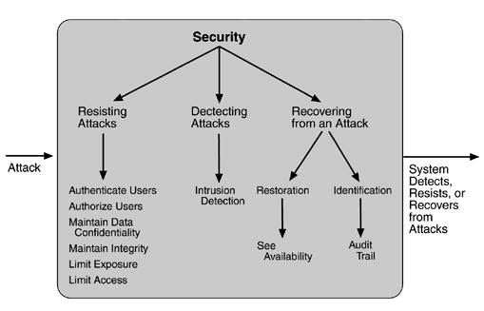
Summary of tactics for security

